Slide 1
Cornerstone City Church Peninsula Plus Community Hoo Are Ya
27th April 2025

Slide 2
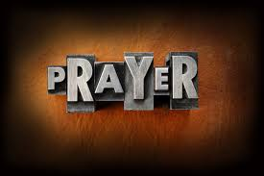

Slide 3
Nothing Is Impossible
CCLI Song # 5199808
Joth Hunt
© 2008 Planetshakers Ministries Int. Inc. (Admin. by Song Solutions www.songsolutions.org)
For use solely with the SongSelect® Terms of Use. All rights reserved. www.ccli.com
CCLI Licence No. 33265

Slide 4
1/7
Through You I can do anything
I can do all things
'Cause it's You who gives me strength
Nothing is impossible
Through You blind eyes are open
Strongholds are broken
I am living by faith
Nothing is impossible

Slide 5
2/7
I'm not gonna live by what I see
I'm not gonna live by what I feel Deep down I know that
You're here with me
And I know that
You can do anything

Slide 6
3/7
Through You I can do anything
I can do all things
'Cause it's You who gives me strength
Nothing is impossible
Through You blind eyes are open
Strongholds are broken
I am living by faith
Nothing is impossible

Slide 7
4/7
I'm not gonna live by what I see
I'm not gonna live by what I feel Deep down I know that
You're here with me
And I know that
You can do anything

Slide 8
5/7
Through You I can do anything
I can do all things
'Cause it's You who gives me strength
Nothing is impossible
Through You blind eyes are open
Strongholds are broken
I am living by faith
Nothing is impossible

Slide 9
6/7
I believe I believe
I believe I believe in You
(REPEAT)

Slide 10
7/7
Through You I can do anything
I can do all things
'Cause it's You who gives me strength
Nothing is impossible
Through You blind eyes are open
Strongholds are broken
I am living by faith
Nothing is impossible

Slide 11
My Redeemer Lives
CCLI Song # 2397964
Reuben Morgan
© 1998 Hillsong Music Publishing Australia (Admin. by Hillsong Music Publishing UK)
For use solely with the SongSelect® Terms of Use. All rights reserved. www.ccli.com
CCLI Licence No. 33265

Slide 12
1/6
I know He rescued my soul His blood has covered my sin I believe I believe My shame He's taken away My pain is healed in His name I believe I believe
I'll raise a banner 'Cause my Lord has conquered the grave

Slide 13
2/6
My Redeemer lives
My Redeemer lives
My Redeemer lives
My Redeemer lives

Slide 14
3/6
I know He rescued my soul His blood has covered my sin I believe I believe My shame He's taken away My pain is healed in His name I believe I believe
I'll raise a banner 'Cause my Lord has conquered the grave

Slide 15
4/6
My Redeemer lives
My Redeemer lives
My Redeemer lives
My Redeemer lives

Slide 16
5/6
You lift my burdens
I'll rise with You
I'm dancing on this mountain top
To see Your kingdom come

Slide 17
6/6
My Redeemer lives
My Redeemer lives
My Redeemer lives
My Redeemer lives

Slide 19
Cornerstone
CCLI Song # 6158927
Edward Mote | Eric Liljero | Jonas Myrin | Reuben Morgan | William Batchelder Bradbury
© 2011 Hillsong MP Songs (Admin. by Hillsong Music Publishing UK)
Hillsong Music Publishing Australia (Admin. by Hillsong Music Publishing UK)
Hillsong Music Publishing UK
For use solely with the SongSelect® Terms of Use. All rights reserved. www.ccli.com
CCLI Licence No. 33265

Slide 20
1/6
My hope is built on nothing less
Than Jesus' blood and righteousness
I dare not trust the sweetest frame
But wholly trust in Jesus' Name

Slide 21
2/6
Christ alone cornerstone
Weak made strong in the Saviour's love
Through the storm He is Lord
Lord of all

Slide 22
3/6
When darkness seems to hide His face
I rest on His unchanging grace
In every high and stormy gale
My anchor holds within the veil
My anchor holds within the veil

Slide 23
4/6
Christ alone cornerstone
Weak made strong in the Saviour's love
Through the storm He is Lord
Lord of all

Slide 24
5/6
When He shall come with trumpet sound
Oh may I then in Him be found
Dressed in His righteousness alone
Faultless stand before the throne

Slide 25
6/6
Christ alone cornerstone
Weak made strong in the Saviour's love
Through the storm He is Lord
Lord of all

Slide 26
Build My Life
CCLI Song # 7070345
Brett Younker | Karl Martin | Kirby Kaple | Matt Redman | Pat Barrett
© 2016 Capitol CMG Genesis (Admin. by Capitol CMG Publishing)
Housefires Sounds (Admin. by Capitol CMG Publishing)
sixsteps Music (Admin. by Capitol CMG Publishing)
Vamos Publishing (Admin. by Capitol CMG Publishing)
worshiptogether.com songs (Admin. by Capitol CMG Publishing)
Said And Done Music (Admin. by Integrity Music Ltd)
Thankyou Music (Admin. by Integrity Music Ltd)
Martin, Karl Andrew (Admin. by Sentric Music)
Bethel Music Publishing (Admin. by Song Solutions)
Kaple Music (Admin. by Song Solutions)
For use solely with the SongSelect® Terms of Use. All rights reserved. www.ccli.com
CCLI Licence No. 33265

Slide 27
1/4
Worthy of ev'ry song we could ever sing
Worthy of all the praise we could ever bring
Worthy of ev'ry breath we could ever breathe
We live for You

Slide 28
2/4
Jesus the name above ev'ry other name
Jesus the only one who could ever save
Worthy of ev'ry breath we could ever breathe
We live for You
We live for You

Slide 29
3/4
Holy there is no one like You
There is none beside You
Open up my eyes in wonder and show me who You are
And fill me with Your heart
And lead me in Your love to those around me

Slide 30
4/4
I will build my life upon Your love
It is a firm foundation
I will put my trust in You alone
And I will not be shaken

Slide 32
Worthy
CCLI Song # 7111931
Chris Brown | Mack Brock | Steven Furtick
© Music by Elevation Worship Publishing (Admin. by Essential Music Publishing LLC)
For use solely with the SongSelect® Terms of Use. All rights reserved. www.ccli.com
CCLI Licence No. 33265

Slide 33
1/6
It was my cross You bore
So I could live in the freedom You died for
And now my life is Yours
And I will sing of Your goodness forevermore

Slide 34
2/6
Worthy is Your name, Jesus
You deserve the praise
Worthy is Your name
Worthy is Your name, Jesus
You deserve the praise
Worthy is Your name

Slide 35
3/6
And now my shame is gone
I stand amazed in Your love undeniable
Your grace goes on and on
And I will sing of Your goodness forevermore

Slide 36
4/6
Worthy is Your name, Jesus
You deserve the praise
Worthy is Your name
Worthy is Your name, Jesus
You deserve the praise
Worthy is Your name (REPEAT)

Slide 37
5/6
Be exalted now in the heavens
As Your glory fills this place
You alone deserve our praise
You're the name above all names (REPEAT)

Slide 38
6/6
Worthy is Your name, Jesus
You deserve the praise
Worthy is Your name
Worthy is Your name, Jesus
You deserve the praise
Worthy is Your name

Slide 40
Holy Forever
CCLI Song # 7201044
Brian Johnson | Chris Tomlin | Jason Ingram | Jenn Johnson | Phil Wickham
© Phil Wickham Music (Admin. by / Small Stone Media BV, Holland (Admin. in the UK/Eire by Song Solutions www.songsolutions.org))
Simply Global Songs (Admin. by / Small Stone Media BV, Holland (Admin. in the UK/Eire by Song Solutions www.songsolutions.org))
Capitol CMG Paragon (Admin. by Capitol CMG Publishing)
S. D. G. Publishing (Admin. by Capitol CMG Publishing)
Be Essential Songs (Admin. by Essential Music Publishing LLC)
My Magnolia Music (Admin. by Essential Music Publishing LLC)
Bethel Music Publishing (Admin. by Song Solutions)
Brian and Jenn Publishing (Admin. by Song Solutions)
For use solely with the SongSelect® Terms of Use. All rights reserved. www.ccli.com
CCLI Licence No. 33265

Slide 41
1/10
A thousand generations falling down in worship
To sing the song of ages to the Lamb
And all who've gone before us
And all who will believe
Will sing the song of ages to the Lamb

Slide 42
2/10
(Jesus) Your name is the highest
Your name is the greatest
Your name stands above them all
All thrones and dominions
All powers and positions
Your name stands above them all

Slide 43
3/10
And the angels cry Holy
All creation cries Holy
You are lifted high Holy
Holy forever

Slide 44
4/10
If you've been forgiven and if you've been redeemed
Sing the song forever to the Lamb
If you walk in freedom and if you bear His name
Sing the song forever to the Lamb
We'll sing the song forever and amen

Slide 45
5/10
And the angels cry Holy
All creation cries Holy
You are lifted high Holy
Holy forever

Slide 46
6/10
Hear Your people sing Holy
To the King of Kings Holy
You will always be Holy
Holy forever

Slide 47
7/10
(Jesus) Your name is the highest
Your name is the greatest
Your name stands above them all
All thrones and dominions
All powers and positions
Your name stands above them all

Slide 48
8/10
And the angels cry Holy
All creation cries Holy
You are lifted high Holy
Holy forever

Slide 49
9/10
Hear Your people sing Holy
To the King of Kings Holy
You will always be Holy
Holy forever

Slide 50
10/10
You will always be Holy
Holy forever

Slide 51


Slide 52
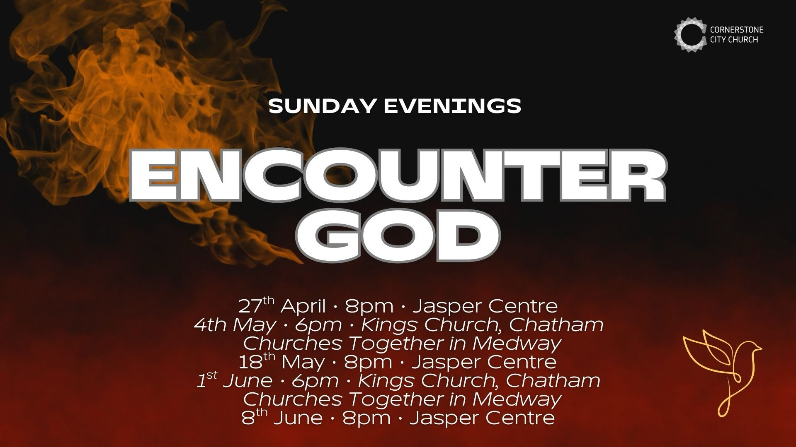

Slide 53


Slide 54
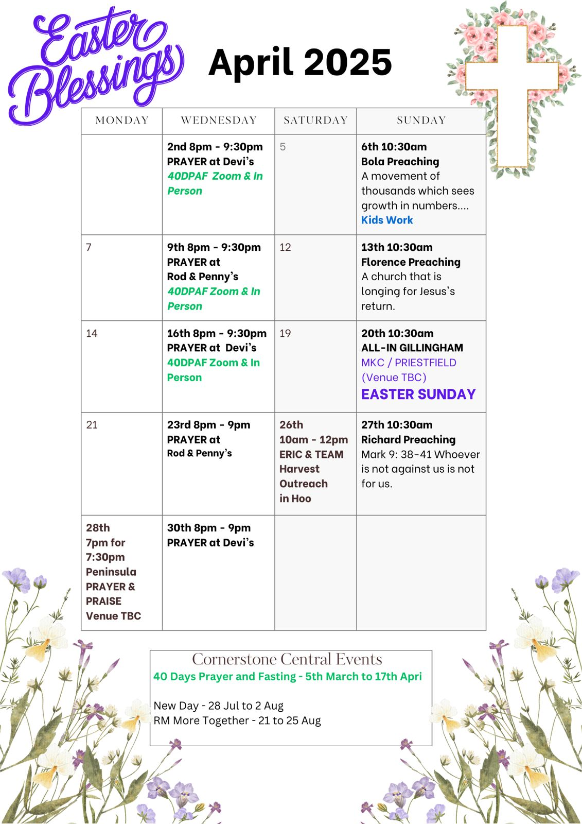

Slide 55

Grow Group 1
On YOUR MARK!

Slide 56
Leaders
Leaderss
Phil & Kim
Maria (Mia) Warren
Matthew Harrison
Richard & Elisha Acheampong
Phil & Kim
Maria (Mia) Warren
Matthew Harrison
Richard & Elisa Acheampong

Slide 57
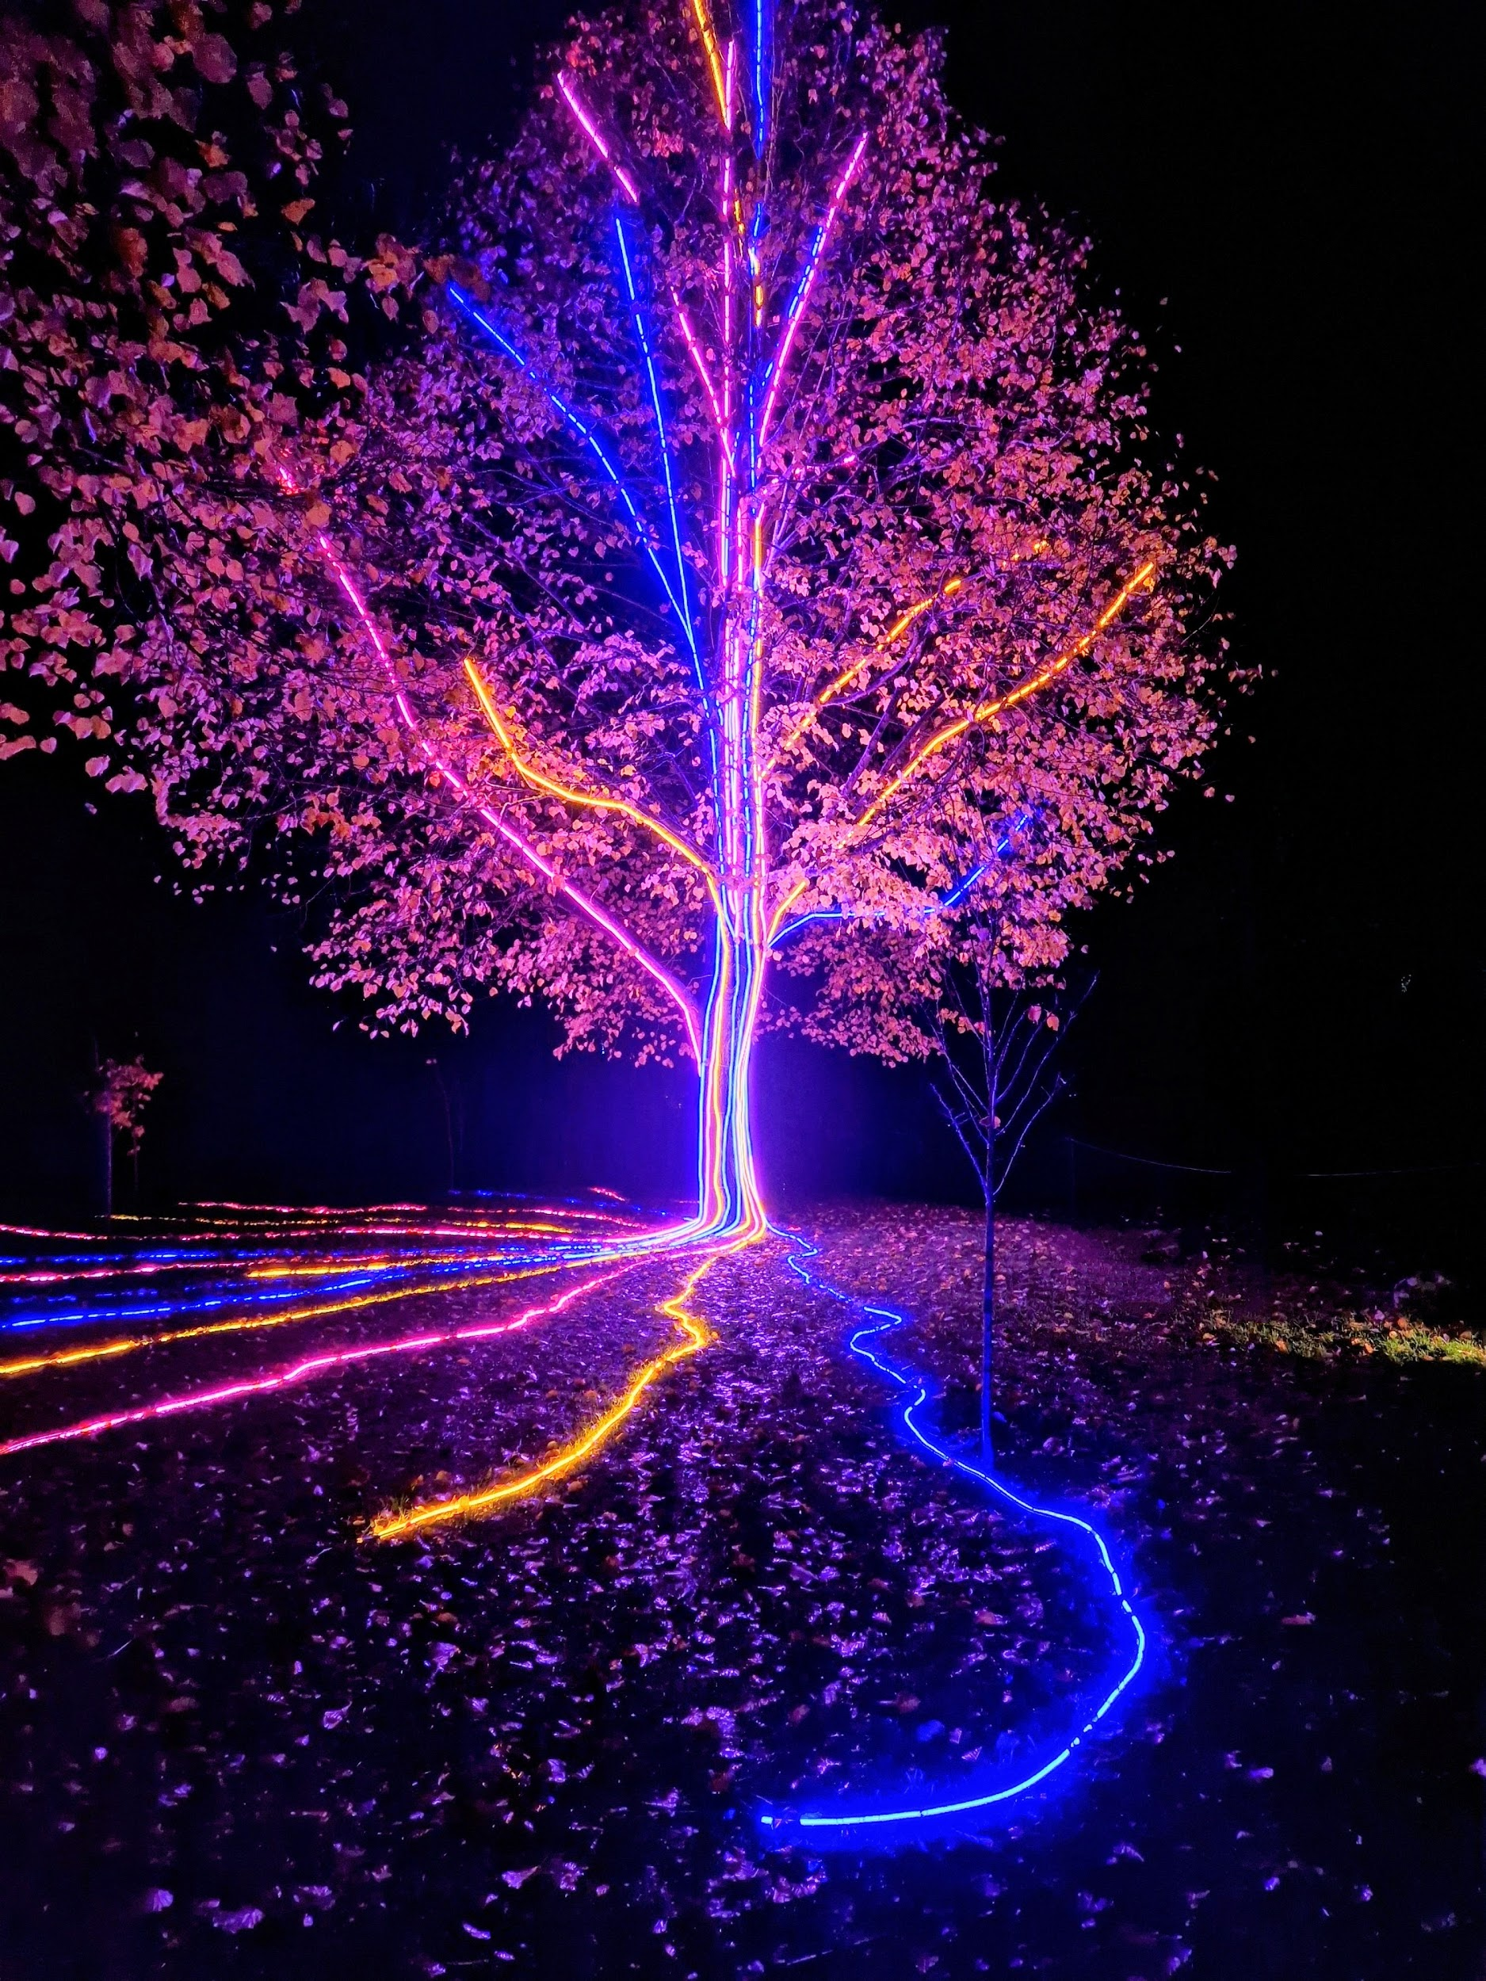
Storm Walker
Storm Walker
Symbolising, trust in Jesus Christ through life's storms.
Mark 4:35-41

Slide 58



Group Leaders
Micheal and Mwamba
Wilfred and Parveen
Hannah

Slide 59


Slide 60
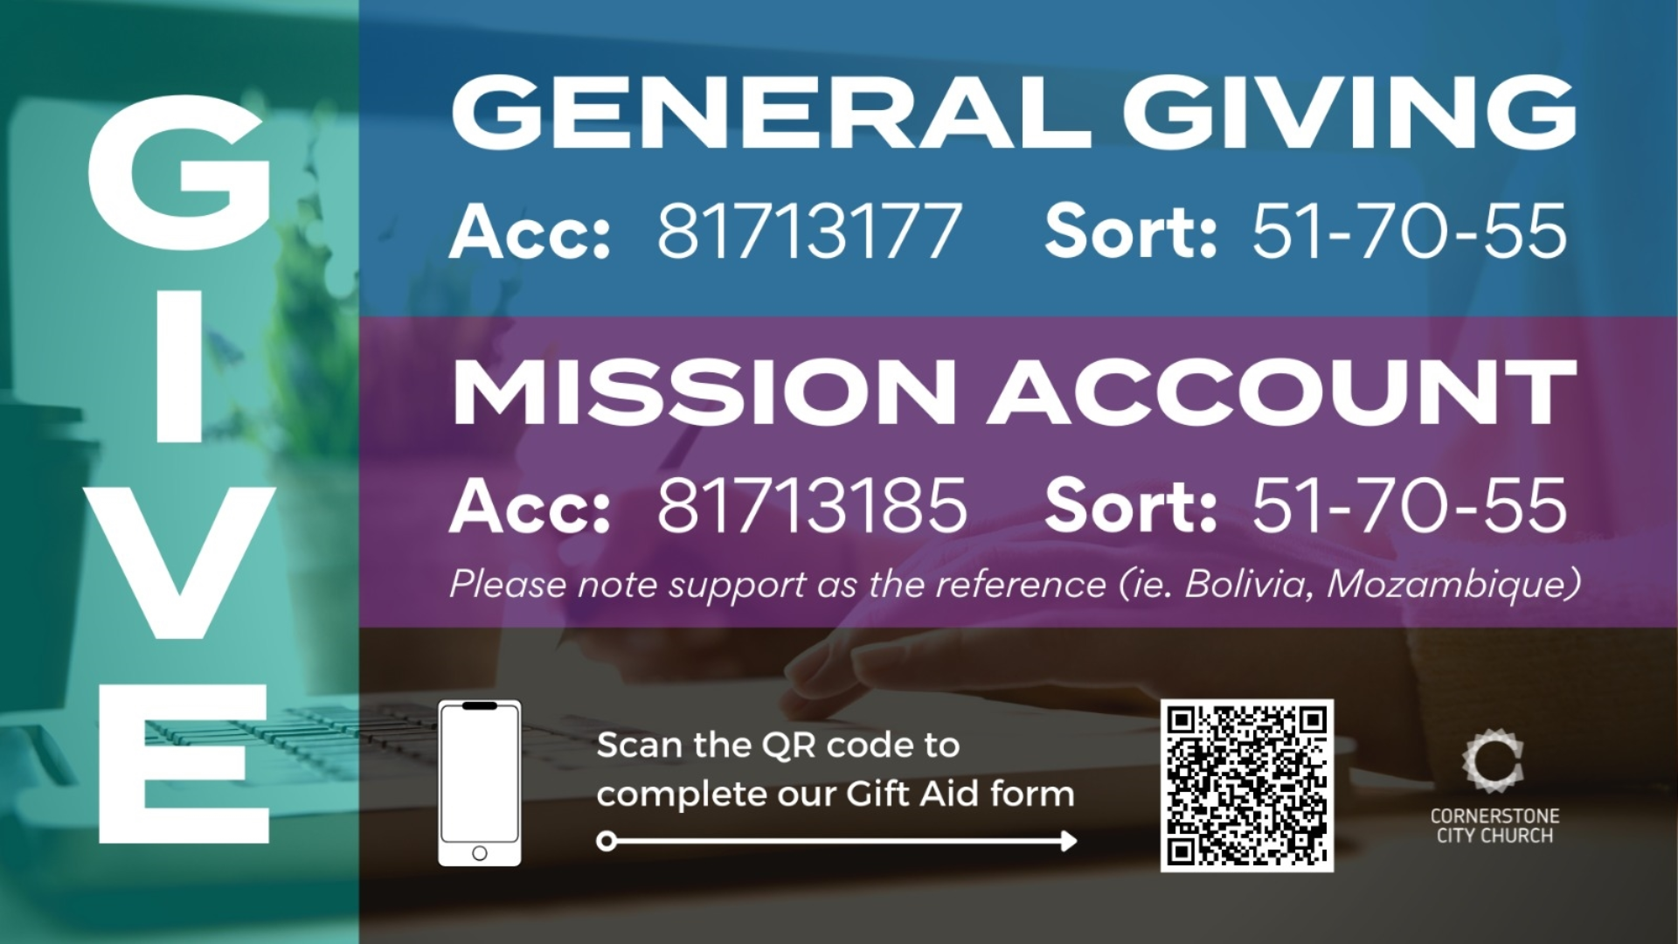

Slide 61
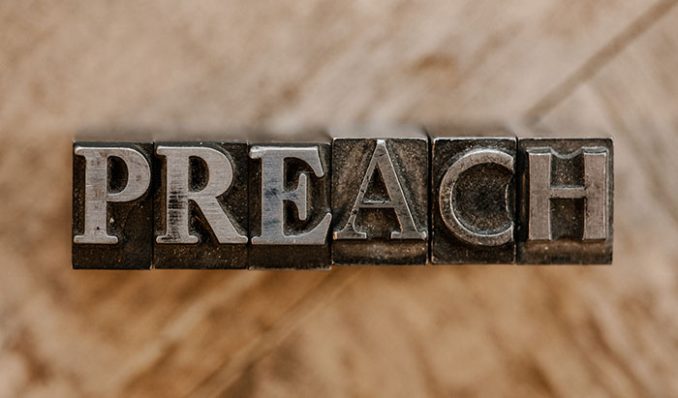

Slide 62
2 Corinthians 14 May the grace of the Lord Jesus Christ, and the love of God, and the fellowship of the Holy Spirit be with you all
Surely goodness and mercy shall follow me all the days of my life, and I shall dwell in the house of the Lord forever.

